Slide 1
UNIT-1
MOBILE APPLICATION DEVELOPMENT
Introduction to Android Mobile App Development

Slide 2
(MR20-1CS0116) Mobile Application Development
UNIT – I Introduction to Android Operating System:
Android OS and Features – Android development framework; Installing and running applications on Android Studio, Creating AVDs, Types of Android application; Creating Activities, Activity Life Cycle, Activity states, monitoring state changes
UNIT – II Android application components :
Android Manifest file, Externalizing recourses like Simple Values, Drawables, Layouts, Menus, etc. Building User Interfaces: Fundamental Android UI design, Layouts – Linear, Relative, Grid and Table Layouts. User Interface (UI) Components
UNIT – III Fragments :
Creating fragments, Lifecycle of fragments, Fragment states, Adding fragments to Activity, adding, removing and replacing fragments with fragment transactions, interfacing between fragments and Activities,
UNIT – IV Intents and Broadcasts:
Using intents to launch Activities, Types of Intents, Passing data to Intents, Getting results from Activities, Broadcast Receivers – Using Intent filters to service implicit Intents, Resolving Intent filters
UNIT – V Database:
Introduction to SQLite database, creating and opening a database, creating tables, inserting retrieving and deleting data;

Slide 3
Unit 1: Introduction to Android Operating System :
Android OS and Features –
Android development framework;
Installing and running applications on Android Studio,
Creating AVDs,
Types of Android application;
Creating Activities,
Activity Life Cycle,
Activity states,
Monitoring state changes

Slide 4
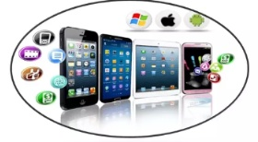
What is mobile application development?
Mobile application development is the set of processes and procedures involved in writing software for small, wireless computing devices, such as smartphones and other hand-held devices.
Mobile apps are often written specifically to take advantage of the unique features of a particular mobile device.
Two most prominent mobile platforms are iOS from Apple and Android from Google.
Phones and tablets from Apple come preloaded with essential applications, including a full web browser and the Apple App Store.
Android devices also come preloaded with similar apps and you can install more using the Google Play Store.

Slide 5
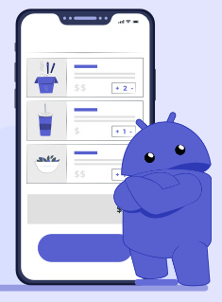
What is operating system
An operating system (OS) is the software component of a computer system that is responsible for the management and coordination of activities and the sharing of the resources of the computer.
The OS acts as a host for application programs that are run on the machine. As a host, one of the purposes of an OS is to handle the details of the operation of the hardware.
The top five OSs, Apple macOS, Microsoft Windows, Google’s Android OS, Linux Operating System, and Apple iOS.
What is Android Application Development?
Android application development is the process of creating software applications designed to run on Android-based devices. These comprise smartphones, tablet devices, smart TVs, smart watches or wearables and even automotive systems.
The primary programming languages used for developing Android apps are Java and Kotlin, supported by the Android software development kit (SDK).
This SDK, along with Android Studio, an official IDE, provides developers with everything they require for designing, writing, debugging, and testing Android applications.

Slide 6
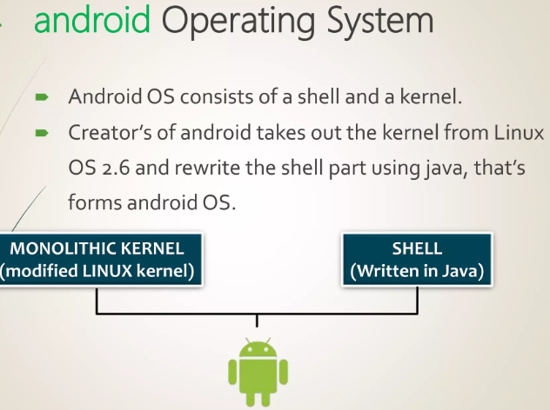
Introduction to Android OS
What is Android?
Android is an open source and Linux-based Operating System for mobile devices such as smartphones and tablet computers.
Android is a stripped version of Linux Operating System i.e. it is compiled to run on smart phones and tablets which have fewer resources in terms of processing power and memory than a personal computer. However, it is still capable of doing daily productive jobs like word processing, sending emails , syncing , sharing , calling and other needs of communication. It had also become a main device of entertainment.
We can stream videos, listen to music and play so many games by downloading apps from Google Play Market. Many of them are free.
This operating system is Open Source and many phone manufacturers like Samsung, HTC, LG have launched new android devices both phones and tablets based on Android.

Slide 7
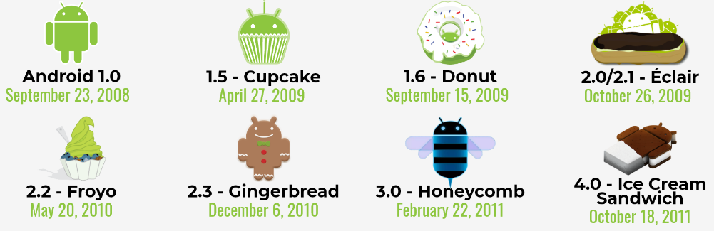
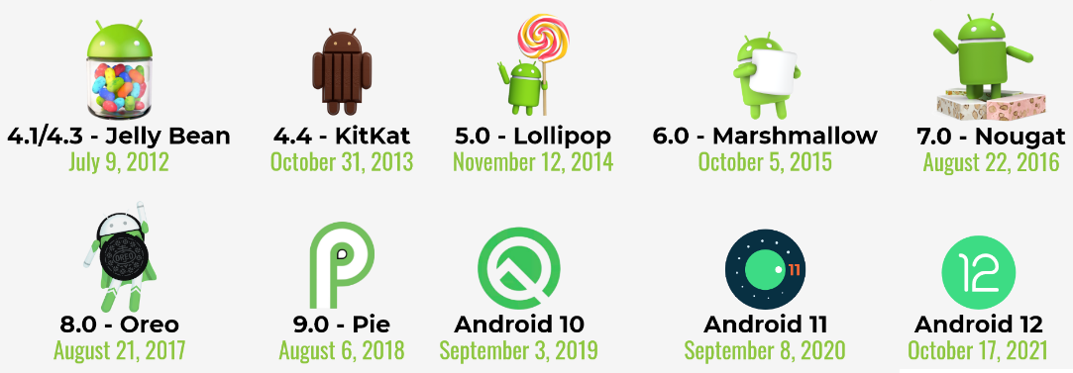


A History Of Android Versions: Since Initial Release To Till Date
August 15, 2022
October 4, 2023

Slide 8


A History Of Android
The story of Android dates back to 2003 when Andy Rubin, Rich Miner, Nick Sears, and Chris White
co-founded a start-up Android Inc. in Palo Alto, California. However, the company was later faced with the insufficiency of funds which brought Google into the picture.
Google could sense the potential the product carried within and sealed a deal worth $50 Million to acquire Android in 2005.
All the four Co-founders soon moved to the Googleplex to continue to develop the OS further under their new owners. The first public Android Beta Version 1.0 was finally published on 5th November 2007.

Slide 9
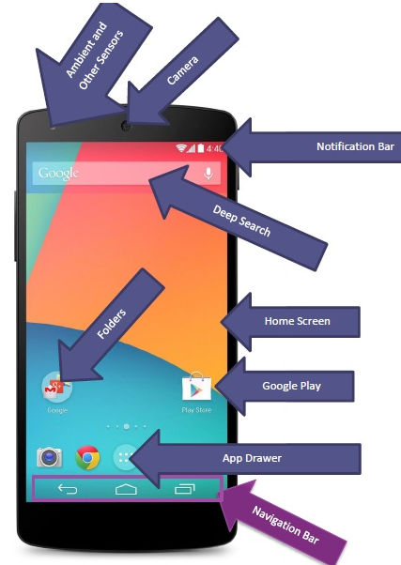
Basics of Android UI
Home Screen- Home Screen is the main screen which you can very easily customize. You can add as many home screens (Depending on the vendor).
App Drawer- App drawer is the area where you can have all your apps installed and contains icons which you can bring on Home screen at any point by just holding and dragging and placing on the home screen.
Google Play Market- It’s a marketplace where you can buy and download free applications.
Search Bar- Its search bar which is integrated with OS such that you can search apps as well as search Google by typing anything in the search.
Navigation Bar- It contains back button, home button, and resent button.
Status Bar- Status bar is actually a notification bar which gives you info about pending information as well as important info like battery, radio signal, Wifi signal and time.
Notification Drawer - Notifications are the brief messages that user can access any time from the status bar. It provides updates; reminders or information which is important

Slide 10
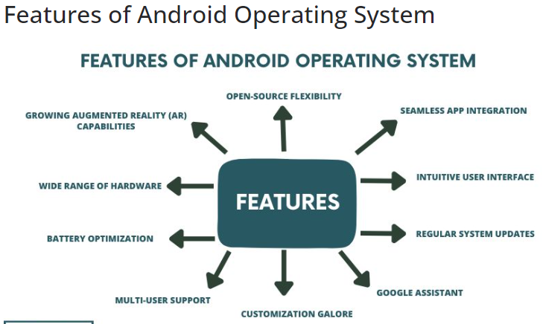
Features of Android OS

Slide 11
1. Open-Source Flexibility
At the core of Android’s appeal lies its open-source nature. Unlike its counterparts, Android welcomes collaboration and modification by developers, leading to a dynamic ecosystem that constantly evolves. This flexibility empowers developers to create customized solutions and users to personalize their devices to match their preferences.
2. Seamless App Integration
One of Android’s standout features is its seamless integration with a vast array of applications. With the Google Play Store serving as a treasure trove of options, users can choose from an extensive selection of apps to enhance their experience. From productivity tools to entertainment platforms, Android ensures that users can tailor their devices to suit their lifestyles seamlessly.
3. Intuitive User Interface
Android’s user interface (UI) has undergone significant refinements over the years, culminating in an intuitive and user-friendly experience. The UI design prioritizes accessibility, ensuring that even novice users can navigate the system with ease. With a focus on simplicity and clarity, Android’s UI sets a benchmark for usability across different age groups and demographics.
4. Regular System Updates
The Android operating system is dedicated to continuous improvement through regular system updates. These updates not only introduce new features but also enhance security protocols and address any potential vulnerabilities. This commitment to keeping devices up-to-date ensures a secure and optimized experience for all users.

Slide 12
5. Google Assistant – Your AI Companion
Among the standout features is the integration of Google Assistant, an AI-powered virtual companion designed to streamline tasks and provide real-time information. With voice commands, users can set reminders, send messages, play music, and even control smart home devices. The ever-evolving capabilities of Google Assistant make it a valuable addition to the Android ecosystem.
6. Customization Galore
Android grants users the freedom to customize their devices extensively. From changing the launcher and theme to installing third-party widgets, the level of personalization is unparalleled. This feature not only reflects individuality but also enhances productivity by tailoring the device’s functionality to specific needs.
7. Multi-User Support
Android recognizes the diverse needs of its users, offering multi-user support on devices such as tablets. This feature is particularly beneficial for families, as each member can have a personalized profile, complete with apps and settings. It ensures a shared device can cater to different preferences without compromising on privacy.
8. Battery Optimization
Efficient battery management is a hallmark of the Android OS. With features like Adaptive Battery, the system learns usage patterns to optimize power allocation to different apps. This translates to extended battery life, ensuring that users can stay connected and engaged throughout their day without worrying about running out of power.

Slide 13
9. Wide Range of Hardware
Android’s compatibility with a wide range of hardware is a significant advantage. Whether it’s a budget-friendly device or a flagship model, the Android OS seamlessly adapts to varying specifications. This inclusivity enables users to choose devices that align with their requirements and budget without sacrificing the operating system’s quality.
10. Growing Augmented Reality (AR) Capabilities
As technology advances, Android remains at the forefront of integrating augmented reality into the user experience. With ARCore, Google’s platform for building augmented reality experiences, Android devices can provide immersive and interactive encounters that bridge the gap between the digital and physical worlds.

Slide 14
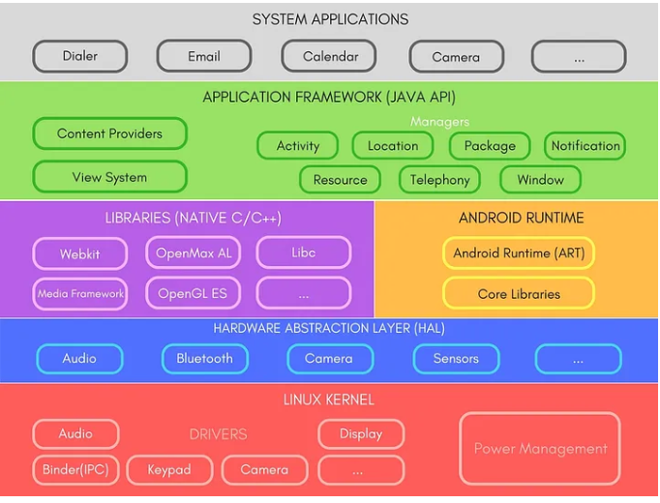
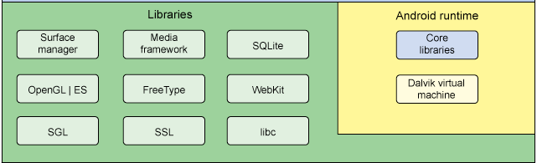
Android Architecture
The Android framework is a set of software components that provide the foundation for building Android applications.
It is divided into five layers:

Slide 15
1. Linux kernel
Bottom layer of android operating system is Linux kernel. Android is built on top of Linux 2.6 Kernel and few architectural changes made by Google. The Linux kernel provides essential services such as hardware abstraction, memory management, process management, and device driver support. Android builds upon the robust and secure foundation of Linux, making it a stable and reliable platform.
Key functions of the Linux kernel layer are:
Hardware Abstraction: The kernel abstracts hardware details, allowing Android to work across a wide range of hardware configurations.
Memory Management: It manages system memory, ensuring efficient allocation and deallocation of resources.
Process Management: The kernel oversees the execution of processes and handles multitasking.
Device Drivers: These drivers enable communication between hardware components and the operating system.
2. Hardware Abstraction Layer (HAL) The Hardware Abstraction Layer (HAL) acts as a bridge between the hardware-specific device drivers and the higher-level Android framework. It ensures that the upper layers of the Android stack remain hardware-agnostic, allowing Android to run on various hardware platforms seamlessly.
The HAL includes libraries and software components that communicate with hardware devices like cameras, sensors, and audio chips. This layer enables Android to support a wide array of devices with different hardware configurations.

Slide 16
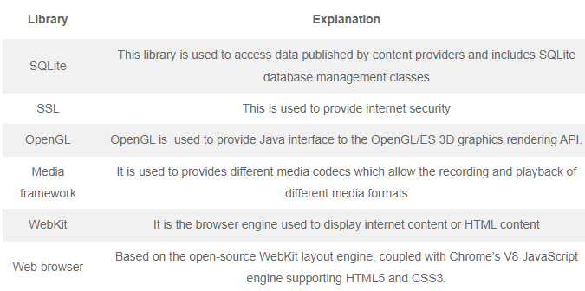
3. Libraries and Android Runtime
Above the HAL, Android uses a combination of libraries and the Android Runtime (ART). It provides the different libraries useful for well functioning of android operating system. The Android component is built using native codes and require native libraries, which are written in C/C++ and most of the libraries are open source libraries. Some of the native libraries are
Android Runtime It provides most important part of android called Dalvik Virtual Machine (DVM). Dalvik Virtual Machine is similar to Java Virtual Machine (JVM) but only difference is that it is designed and optimized for Android. DVM uses core functions of Linux such as memory management and multi threading and enables each android app to run its own process. It basically converts .java file into .Dex format.

Slide 17
4. Android Framework
This layer provides the basic building blocks for Android applications The Android Framework is a collection of Java classes and libraries that provide the core functionalities and building blocks for Android applications. It includes classes for managing the user interface, accessing hardware resources, and communicating with other applications
It consists of various modules:
- Activity Manager: Manages the lifecycle of Android applications and their components, such as activities and services.
- Content Providers: Allow apps to share data and access it securely. They act as a bridge between applications and databases.
- Notification Manager: Handles notifications generated by apps and system events.
- Location Manager: Enables apps to access location-based services.
- Connectivity Manager: Manages network connections, including Wi-Fi and mobile data.
The Android Framework also includes the Application Framework, which allows developers to build custom applications using pre-built components.
5. Applications
At the top of the Android architecture stack are the applications themselves. These can be pre-installed system apps, such as the phone dialer and messaging app, or third-party apps installed by users from the Google Play Store or other sources.
Android apps are written in Java or Kotlin and interact with the Android Framework through APIs. They leverage the framework’s components and services to provide various functionalities to users.

Slide 18
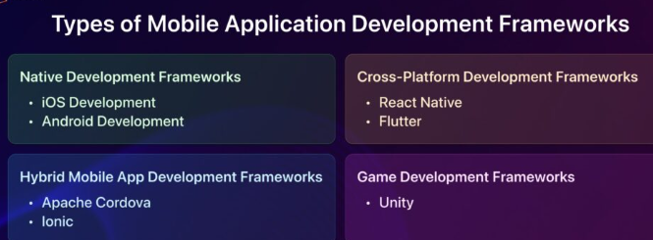
Android development framework
In general, the basic method of creating an Android app is to use Android Studio (As it is the official IDE for Android).
However, there are many other Android Development Frameworks that are quite popular.
There are several types of mobile application development frameworks, each catering to different needs and platforms. Here are some common categories

Slide 19
1.Native Development Frameworks: These frameworks are platform-specific, allowing developers to build apps for a single platform using the platform’s native language and tools. Examples include:
iOS Development (Swift/Objective-C): For Apple devices, Swift and Objective-C are used for native iOS app development. Android Development (Java/Kotlin): For Android, Java and Kotlin are the primary languages for building native apps.
2. Cross-Platform Development Frameworks: These frameworks enable developers to create apps for multiple platforms using a single codebase. Examples include:
React Native: Developed by Facebook, React Native allows developers to build mobile apps for iOS and Android using JavaScript and React. It’s used by companies like Facebook, Instagram, and Airbnb.
Flutter: Created by Google, Flutter is another cross-platform framework using Dart, and it’s known for building beautiful, natively compiled applications. Apps like Alibaba and Google Ads have been developed using Flutter.
3. Hybrid Mobile App Development Frameworks:
Hybrid mobile app development frameworks combine native and web technologies, usually relying on web views to render content within a native app. Examples include:
Apache Cordova (PhoneGap): It allows developers to use HTML, CSS, and JavaScript to build cross-platform apps. Adobe PhoneGap is a popular variation.
Ionic: Built on top of Cordova, Ionic provides a UI framework and tools for building hybrid apps.
4. Game Development Frameworks: These frameworks are specialized for creating mobile games. Examples include:
Unity: It’s a versatile game engine that supports mobile platforms like iOS and Android. Games like “Pokémon GO” and “Super Mario Run” were built using Unity.

Slide 20
Installation of Android Studio
Android Studio provides a complete integrated development environment (IDE) including an advanced code editor and a set of app templates. In addition, it contains tools for development, debugging, testing, and performance that make it faster and easier to develop apps. You can test your apps with a large range of preconfigured emulators or on your own mobile device, build production apps, and publish on the Google Play store.
Procedure:
Step 1: Download from https://developer.android.com/studio/index.html
Step 2: Run Setup → Next… → Finish
Step 3: Import Studio Setting Opton → Do not Import Settings
Step 4: Install Type Option → Standard
Step 5: Select UI Theme → Done

Slide 21
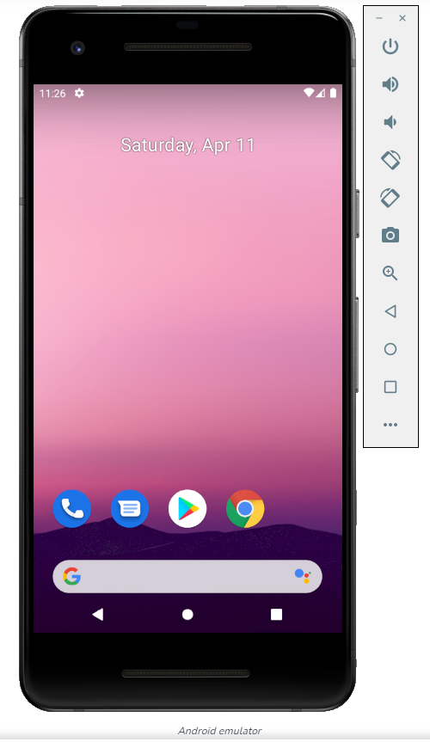
What is an Android Virtual Device (AVD)
An Android Virtual Device is basically a device configuration. It is similar to Android Mobiles, Tablets, or any other Android device.
The developers can test the applications that they have developed on AVDs.
An AVD is a software that imitates a real hardware android device. It has a hardware image, a storage system, applications, and other things just like a real device.
We need it during the development of an Android Project or Application. Since it provides a virtual representation of an application, it helps us to run our application on itself. It is required to ensure that our app works correctly.
It eliminates the task of connecting a mobile device and installing the application again and again. It helps us test the app and its functions correctly and resolve malfunctions
Android Emulator allows you to run emulations of Android devices on Windows, macOS or Linux machines. The Android Emulator runs the Android operating system in a virtual machine called an Android Virtual Device (AVD).

Slide 22
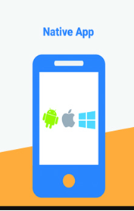
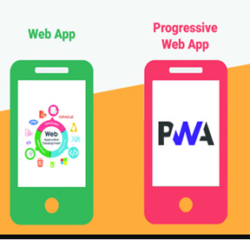
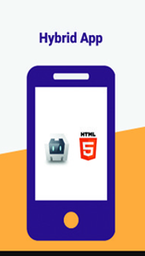
Types of Android application

Slide 23
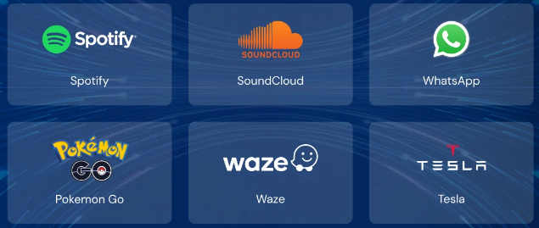
1. Native Apps:
Native Apps are written in a specific programming language to work on a particular Operating system.
A majority of the smartphones either run an Android OS or the iOS if it’s an apple device. Native Apps are specifically built for specific OS to make the most of the functionalities of the devices that run the particular OS. And hence native apps cannot be used on different types of operating system. Blackberrry, Symbian, and Windows phone are functional only on their respective platform.
Technology Used: Xcode and Objective-C are mainly used for iOS apps, and Eclipse, Kotlin and Java are used to build Android apps.
Native apps are generally built to make the most of all the features and tools of the phones such as contacts, camera, sensors, etc. Native apps ensure a high performance and elegant user experience as the developers use the native device UI to build apps.
Native apps are easily available on the OS specific apps stores.For example you will find native Android apps on Google Play Store, iOS apps on App Store, and windows apps on the microsoft store
Advantages of native apps:
1. Fast performance due to simple code specific to device and OS.
2. Better use of OS and device specific functionalities.
3. Interactive UI/UX.
4. Lesser compatibility issues and faster to configure.
5. Offline connection
Few Popular native mobile applications
Music
Music
Communication
Disadvantages of native apps:
1. Building OS specific apps can be time-consuming
2. OS specific programming languages like swift and java are hard to learn.
3. Longer release cycles to ensure stability.
4. Requires separate codebase to add new features.
Entertainment
Navigation
Tech control

Slide 24




2. Web Apps
Web apps behave similarly to native apps but are accessed via a web browser on your mobile device.
They’re not standalone apps in the sense of having to download and install code into your device.
It does not require any storage space or installation process to use the app. Mobile web apps adapt to various screen sizes and devices easily.
One of the major differences between the native apps and mobile apps, is that native mobile apps can function both in the offline mode and the online mode, whereas the web apps require an active internet connection for them to work. Since these apps are not installed on your smartphone, there is no need for updating the web app as they update themselves on the web-hosted servers.
Technology Used: Web apps are designed using HTML5, CSS, JavaScript, React, Ruby, and similar programming languages used for web work.
Advantages of web apps:
1. Reduced business cost.
2. No installation needed.
3. Better reach as it can be accessed from anywhere.
4. Always up-to-date.
Few Mobile Web Apps
Disadvantages of web apps:
1. Web apps fail to work when you are offline.
2. Limited number of functionalities as compared to Native apps.
3. It takes a longer time to develop.
4. Security risk.

Slide 25
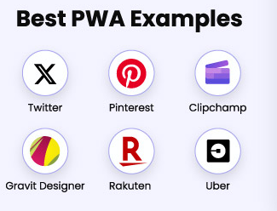

3. Progressive Web Apps (PWAs)
Progressive Web Apps (PWAs) are extensions of the website that you can save on your computer systems or devices and use like an app. When you come across the option to “install” a web app, it often simply bookmarks the website URL on your device. One kind of web app is the progressive web app (PWA), which is basically a native app running inside a browser. PWAs use web browser APIs and functionalities to bring a native app-like experience across devices. It is a type of a webpage that can be added onto your devices or computer systems to mimic a web application. The PWAs run fast regardless of the Operating Systems and devices types.
Advantages of Progressive web apps:
1. They use very little data – An app which takes close to 10 MBs as a native app, can be reduced to about 500KB when made a PWA.
2. PWAs get updated like web-pages. They automatically get updated every time you use them.
3. There is no need for installation as PWAs are simple web-pages. Users choose to ‘install’ when they like it.
4. You can easily share PWAs by simply sending its URL.
Disadvantages of progressive apps:
1. There are limitations to using all the Hardware and Operating Systems features.
2. PWAs can pose a few hardware integration problems.
3. Full support is not available in default browsers of some of the manufacturer’s.

Slide 26
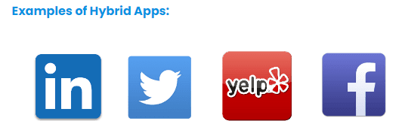
4. Hybrid Apps
Hybrid apps combine the best of both native and web apps. The hybrid apps are written using HTML, Javascript, and CSS web technologies and work across devices running different OSs.
Development teams will not need to struggle with Objective-C or Swift to build native apps anymore, and use standard web technologies like Javascript, Angular, HTML and CSS.
The mobile development framework Cordova wraps the Javascript/HTML code and links the hardware and functions of the device.
Hybrid Apps are built on a single platform and distributed across various app stores such as Google Play store or Apple’s app store similar to Native apps.
Hybrid apps are best used when you want to build apps that do not require high-performance, full device access apps.
Advantages of hybrid apps:
1. Easy to build
2. Shareable code makes it cheaper than a native app
3. Easy to push new features since it uses a single code base.
4. Can work offline.
5. Shorter time to market, as the app can be deployed for multiple OSs.
Disadvantages of Hybrid apps:
1. Complex apps with many functions will slow down the app.
2. More expensive than web apps
3. Less interactive than native apps
4. Apps cannot perform OS specific tasks

Slide 27
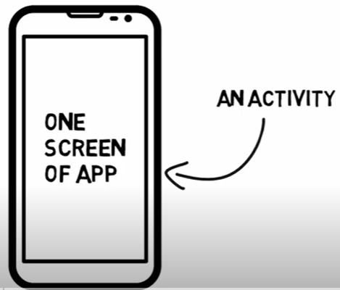
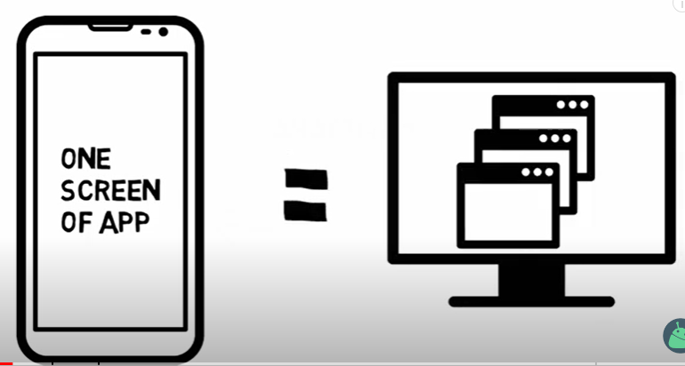
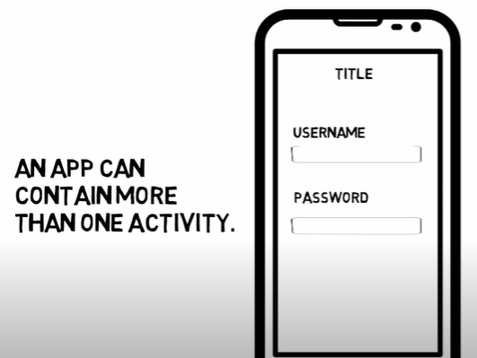
WHAT IS AN ACTIVITY
An activity is one screen of an app.
In that way the activity is very similar to a window in the Windows operating system or like a web page of a website.
The most specific building block of the user interface is the activity.
An Android app contains activities, meaning one or more screens.
Examples: Login screen, sign up screen, and home screen.
Activity is nothing but a java class in Android which has some pre-defined functions which are triggered at different App states
Every application which has UI must inherit it to create a window.
Whenever we open any application, one of its activity opens, its called the Launcher Activity.
When you create a new project, android studio creates an activity by name “MainActivity.java” and its XML file my name “activity_main.xml“. It is the activity that opens up when an app is opened.

Slide 28
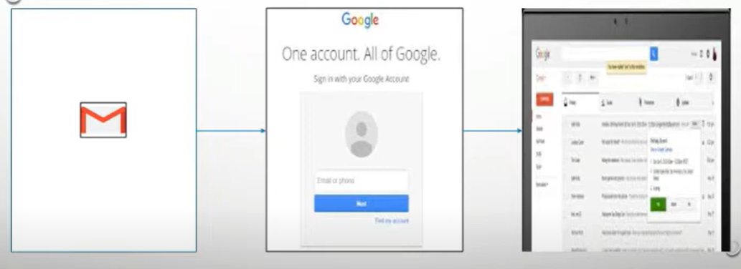
EXAMPLE

Slide 29
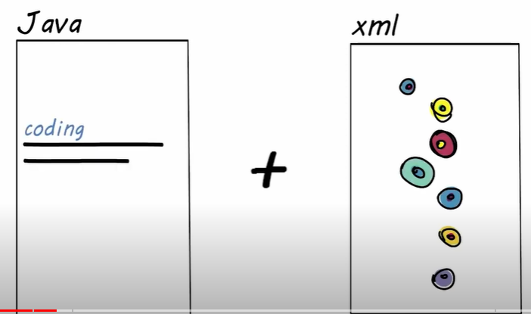
HOW DOES ACTIVITY WORK
An activity in Android is a specific combination of XML files and JAVA files.
It is basically a container that contains the design as well as coding stuff.
XML files provide the design of the screen and JAVA files deal with all coding stuff like handles, what is happening, design files, etc
JAVA files and XML files make your activity complete.

Slide 30
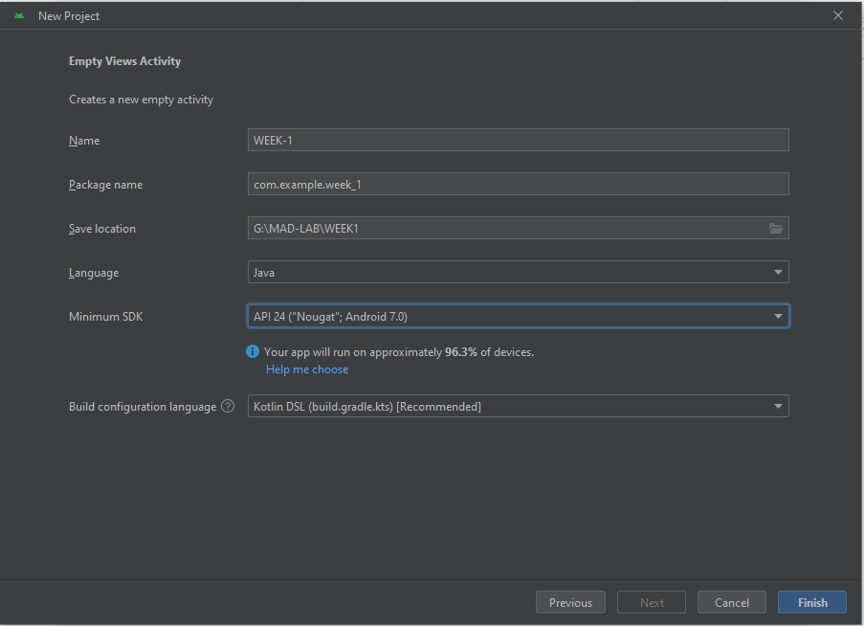
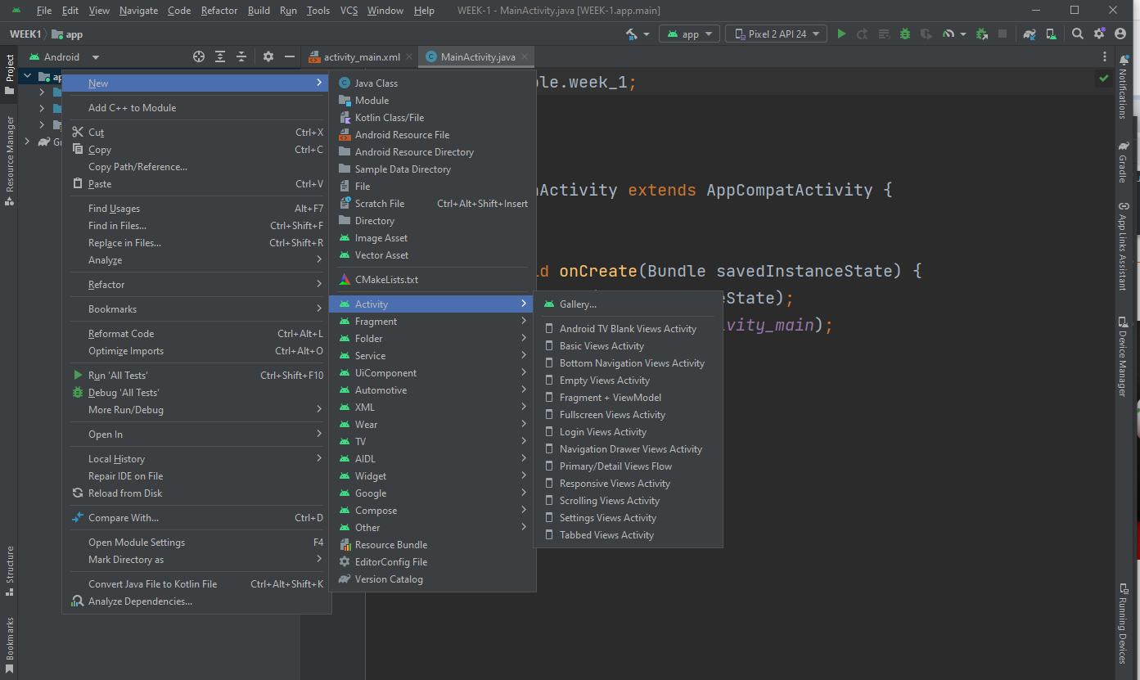
Creating Activities
Steps to Create a New Activity in Android Studio
Step 1: First step is to open or create an android project in you android-studio.
Step 2: Right click on the app directory and choose new → activity

Slide 31
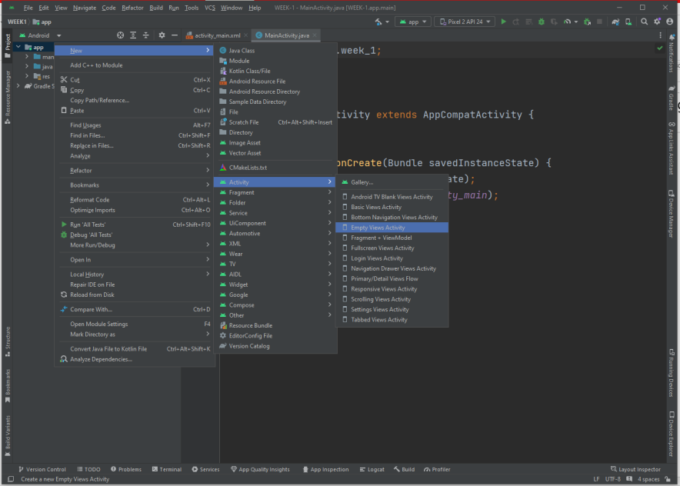
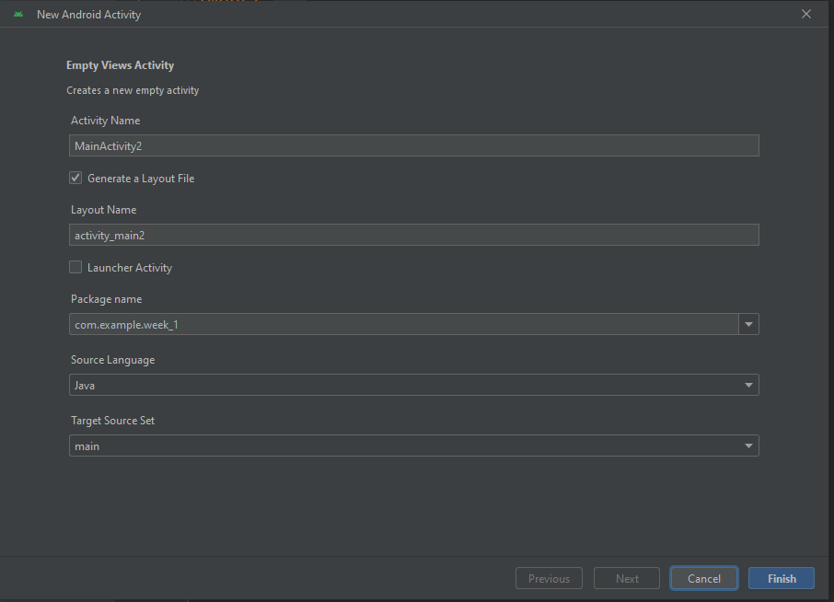
Step 3: You have variety of activities to choose from. According to our need choose one. Here chosen an Empty view Activity.
Step 4: It make a window to pop up and according to the chosen activity ask for basic information like name etc.
Step 5: Fill the name and other information if you want to and press FINISH.
Step 6: It will open the activity automatically and corresponding layout file.

Slide 32
Activity Life Cycle / LIFECYCLE OF ACTIVITY
As a user navigates through, out of, and back to your app, the Activity instances in your app transition through different states in their lifecycle.
The Activity class provides several callbacks that allow the activity to know that a state has changed, that the system is creating, stopping, resuming, or destroying an activity. Within the lifecycle callback methods, you can declare how your activity behaves when the user leaves and re-enters the activity.
For example, if you’re building a streaming video player, you might pause the video and terminate the network connection when the user minimizes the app. When the user returns, you can reconnect to the network and allow the user to resume the video from the same spot.
Each callback allows you to perform specific work that is well suited for a given change of state.
Doing the right work at the right time and handling transitions properly make your app more robust and performant and helps make the user experience better.

Slide 33
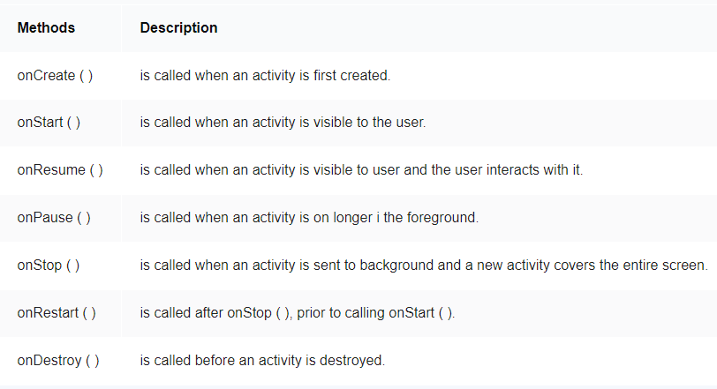
The Activity class provides a core set of seven callbacks

Slide 34
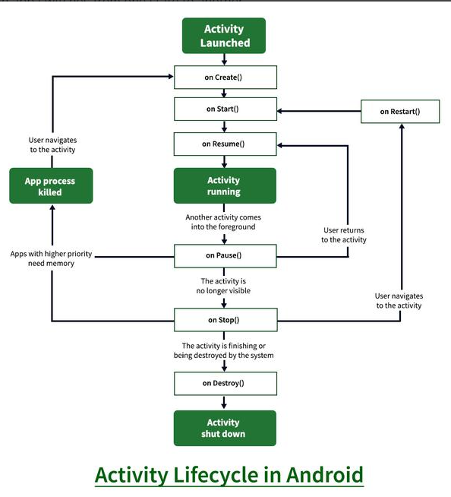
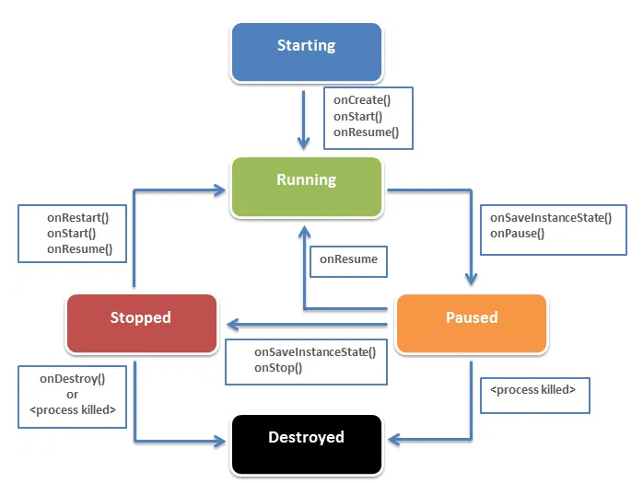

Slide 35
1. onCreate( )
This callback is fired when the system first creates the activity. In onCreate method, all such operations are performed which should be done only once for the entire life of the activity.
This method has a parameter savedInstanceState which is a bundle object. It contains activity’s previous saved state. If the activity has never existed before, the value of Bundle object is null.
public class MainActivity extends AppCompatActivity { @Override protected void onCreate(Bundle savedInstanceState)
{ super.onCreate(savedInstanceState); setContentView(R.layout.activity_main); } }
2. onStart( )
When the activity enters the Started state, the system invokes this callback. The onStart( ) call makes the activity visible to the user, as the app prepares for the activity to enter the foreground and become interactive. This method can be used to initialize the code that maintains the user interface. After onStop( ) , if activity restarts then onStart( ) is called.
onCreate ( ) function is called only once but onStart( ) can be called multiple times , when activity enters the started state.

Slide 36
3. onResume( )
The onStart( ) method completes very quickly and, as with the Created state, the activity does not stay resident in the Started state. Once this callback finishes, the activity enters the Resumed state, and the system invokes the
onResume( ) method.
This is the state in which the app interacts with the user. The app stays in this state until something happens to take focus away from the app. Such an event might be, for instance,
receiving a phone call,
the user’s navigating to another activity, or
the device screen’s turning off.
When such an event occurs, the activity enters the Paused state, and the system invokes the onPause( ) callback.
4. onPause( )
The system calls this method as the first indication that the user is leaving the activity (though it does not always mean the activity is being destroyed); it indicates that the activity is no longer in the foreground (though it may still be visible if the user is in multi-window mode).
In most case onPause() method called by Android OS when user press Home button (Center Button on Device) to make hide. Activity is not visible to user and goes in background when onPause() method is executed
When the activity moves to the paused state, any lifecycle-aware component tied to the activity’s lifecycle will receive the onPause( ) event. This is where the lifecycle components can stop any functionality that does not need to run while the component is not in the foreground
onPause( ) method can be used to release system resources, handles to sensors (like GPS), or any resources that affect battery life while your activity is paused and the user does not need them.

Slide 37
5. onStop( )
When your activity is no longer visible to the user, it has entered the Stopped state, and the system invokes the onStop( ) callback. Any activity gets stopped in case some other activity takes place of it. For example, if a user was on screen 1 and click on some button and moves to screen 2. In this case Activity displaying content for screen 1 will be stopped.
The system may also call onStop( ) when the activity has finished running, and is about to be terminated.
In the onStop( ) method, the app should release or adjust resources that are not needed while the app is not visible to the user. It should be used to perform relatively CPU-intensive shutdown operations. So Activity will be in stopped state when hidden or replaced by other activities that have been launched or switched by user
6. onRestart( )
onStart( ) will always be called whenever you enter your Activity just after onCreate( ) but the onRestart( ) will only be called before onStart( ) when your Activity comes from being stopped (passing from onStop( )) back to the vision.
7. onDestroy( )
onDestroy( ) is called before the activity is destroyed. The system invokes this callback either because:
1. if user pressed the back navigation button then activity will be destroyed after completing the lifecycle of pause and stop.
2.In case if user press the home button and app moves to background. User is not using it no more and it’s being shown in recent apps list. So in this case if system required resources need to use somewhere else then OS can destroy the Activity.
After the Activity is destroyed if user again click the app icon, in this case activity will be recreated and follow the same lifecycle again.

Slide 38
When you open the app it will go through below states:
onCreate() –> onStart() –> onResume()
When you press the back button and exit the app
onPaused() — > onStop() –> onDestory()
When you press the home button
onPaused() –> onStop()
After pressing the home button, again when you open the app from a recent task list
onRestart() –> onStart() –> onResume()
After dismissing the dialog or back button from the dialog
onResume()
If a phone is ringing and user is using the app
onPause() –> onResume()
After the call ends
onResume()
When your phone screen is off
onPaused() –> onStop()
When your phone screen is turned back on
onRestart() –> onStart() –> onResume()

